Slide 1

Support the management of trauma in the Emergency and Urgent Care Setting
Component 8
Chest Injuries
Notes:
Learners will need access to JRCALC PLUS

Slide 2

Chest Injuries – Component 8
OBJECTIVE
Understand signs and symptoms, complications and treatment for chest injuries.
Explain when interventions may be required.
Describe time critical injuries and when action should be taken.

Slide 3
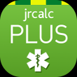
Chest Injuries – Component 8
Chest trauma accounts directly for 25% of all trauma deaths and is a contributing factor to approximately another 50%
Despite the very high percentage of serious chest injuries, the vast majority of them can be managed in hospital with chest drainage and resuscitation and only 10-15% require surgery.
Major causes of chest trauma are – RTCs, Industrial accidents & sporting injuries.
The most common problem associated with major chest injuries is HYPOXIA caused either by impaired ventilation or secondary to hypovolaemia
Notes:
Ref: Ambulance Care Essentials 2nd Edition – Chapter 16 pg 272-275
JRCALC PLUS – Guidelines – Trauma – Thoracic Trauma

Slide 4
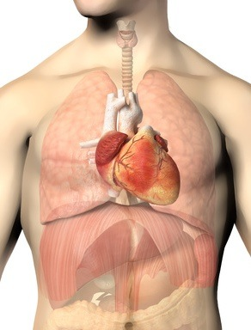
What Can Get Injured?
Chest Injuries – Component 8
Heart
Blood Vessels
Lungs
Airways
Soft Tissue
Bones
Spinal Cord
Nerves
Notes:
Ref: Ross and Wilson 12th Edition – Chapter 3 pg 49-50

Slide 5
THINK
Chest Injuries – Component 8
If the patient has rib injuries there could also be injuries to :
Liver
Kidneys
Spleen
(Stomach, Pancreas, Gall Bladder)
ALWAYS remember – Could there be a neck/spinal injury

Slide 6
Mechanism of injury MOI
MOI is an important guide to the likelihood of significant chest injuries.
Blunt force (RTC/ fall/ sports injuries):
  On scene time of less than 20 minutes
Penetrating trauma (Gun shot/ stab wounds/ industrial/ domestic):
  On scene time of minutes
Notes:
Ref: Ambulance Care Essentials 2nd Edition – Chapter 16 pg 247-252
Aug24: Wording in JRCALC is ‘minutes’. Guidance is to undertake essential interventions on scene and move to definitive care ASAP. No delays on scene for obs or waiting for a senior clinician if the hospital is closer.
Choose the most efficient method of extrication to the ambulance.
Patients who can safely walk may be allowed to do soObtain relevant vital signs only – Temperature, blood sugar and 12 lead ECG are not needed.
If possible, provide all non-emergent interventions (including analgesia), while en-route to hospital
JRCALC Plus (jrcalcplusweb.co.uk)

Slide 7
Mechanism of Injury
Chest Injuries – Component 8
THINK about :
The force & energy delivered
The duration & direction
Notes:
Ref: Ambulance Care Essentials 2nd Edition – Chapter 16 pg 262
JRCALC PLUS – Guidelines – Trauma – Thoracic Trauma

Slide 8
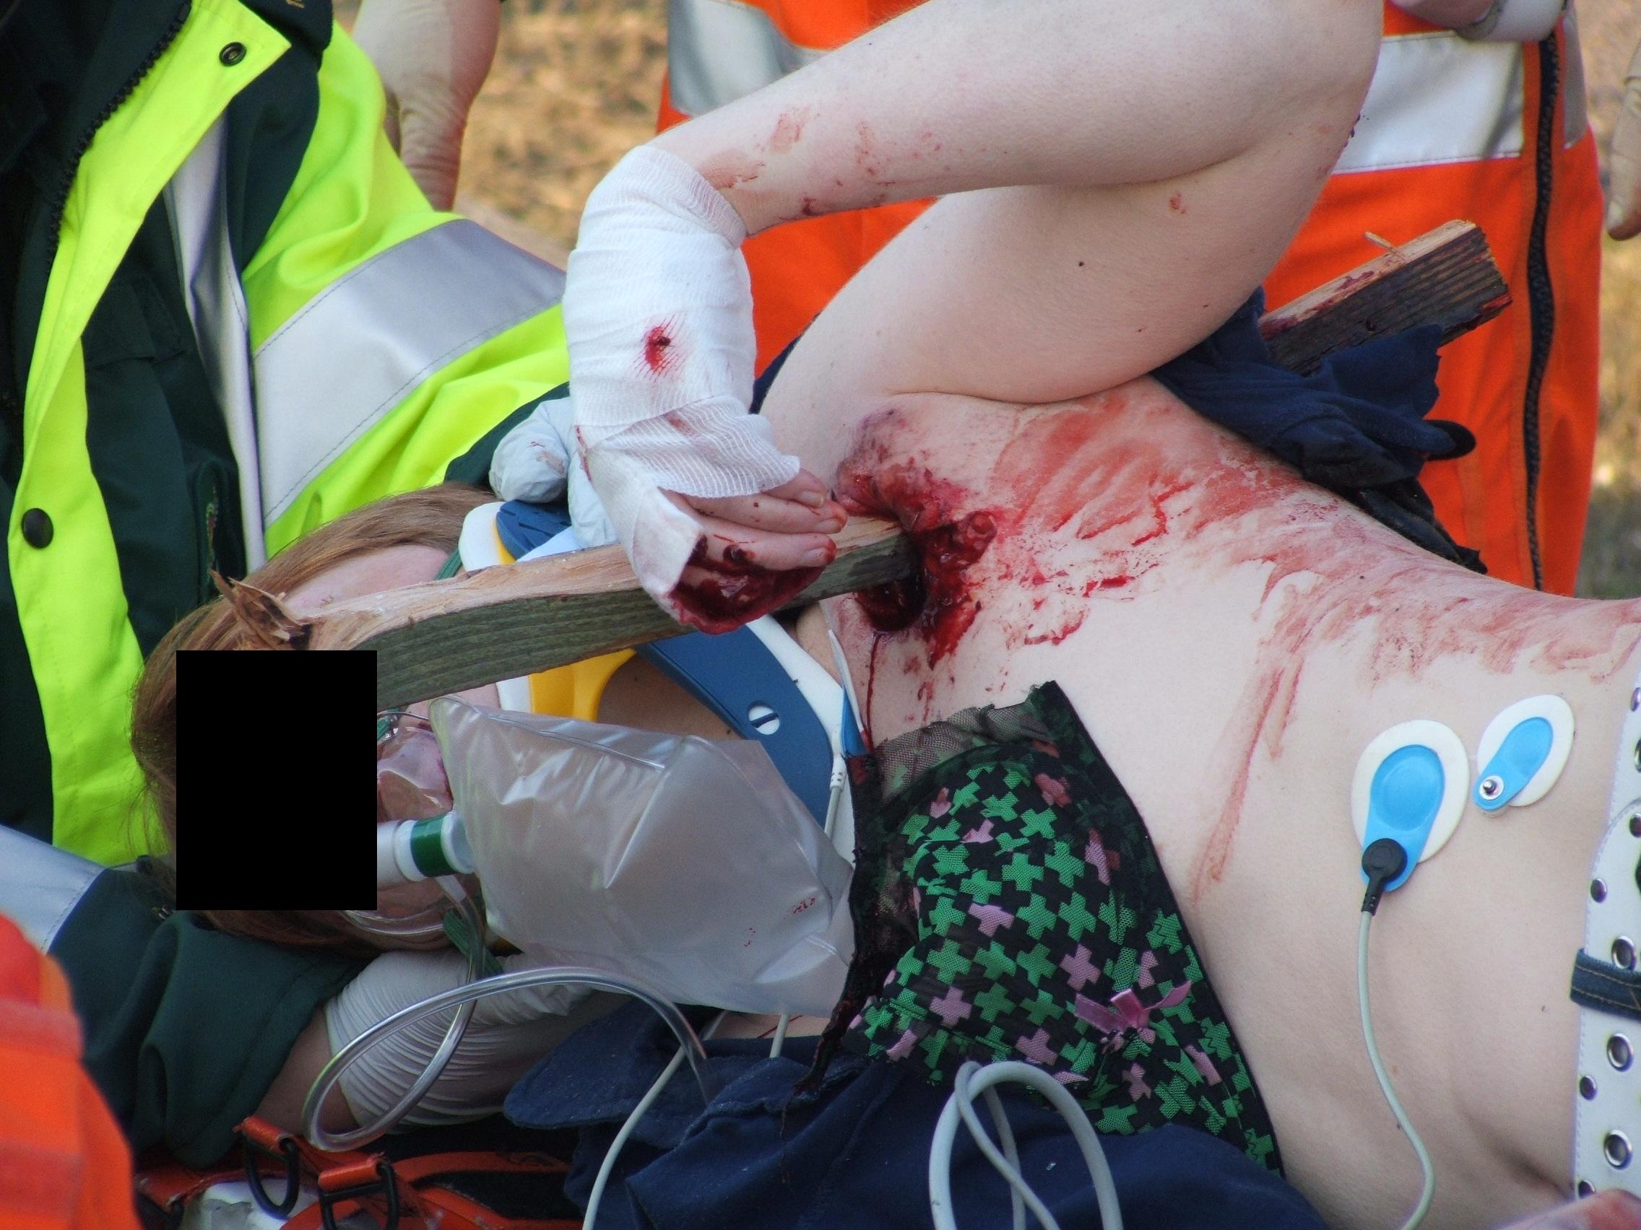
Consider
Chest Injuries – Component 8
Has the patient been stabbed
Has the patient been shot
Has the chest of the patient been crushed or compressed
Did the driver of the car hit a wall at speed
Has the patient been kicked / punched / hit with an object
Did the patient fall from a height and what have they fallen onto.
Is the patient elderly or a child/infant.
Will you require advanced interventions from a senior clinician or assistance from police, LFB if so request assistance ASAP

Slide 9
Possible Signs & Symptoms of a chest injury
Chest Injuries – Component 8
Hypoxia, Dyspnoea, Tachypnoea, Bradypnoea
Shallow respirations, use of accessory muscles
Abnormal chest wall movement
Deformity, bruising, swelling, wounds
Pain, tenderness
Obvious blood loss, signs of clinical shock
Reduced levels of consciousness
Anxiety
The severity of signs and symptoms can vary widely depending on the specific type and extend of injury ALWAYS THINK is the patient TIME CRITICAL
Notes:
Ref: Ambulance Care Essentials 2nd Edition – Chapter 16 pg 272-275
JRCALC PLUS – Guidelines – Trauma – Thoracic Trauma
Probably worth reinforcing that the student might not be able to diagnose a specific injury – as there are generic signs and symptoms for many different chest injuries
Also stress that the severity of the signs and symptoms can vary widely between different injuries
And introduce the concept that a patient may at first appear stable but then rapidly deteriorate

Slide 10
Types of Injuries caused by chest trauma
Chest Injuries – Component 8
There are many different types of chest injuries your patient could suffer :-
If the force of the injury is sufficient, the damage and deformity to the chest wall structures may induce tearing and contusion to the lungs and other structures causing respiratory problems and pain ( Rib injuries )
Myocardial Contusion – Caused by blunt trauma to the sternum, which may result in cardiac rhythm disturbances
Damage to the lungs with bleeding causing a haemothorax or an air leak causing a pneumothorax
Rapid deceleration injuries may result in sheering forces that are sufficient to rupture great vessels such as the aorta.
Notes:
Ref: Ambulance Care Essentials 2nd Edition – Chapter 16 pg 272-275
JRCALC PLUS – Guidelines – Trauma – Thoracic Trauma

Slide 11
Rib Injuries
Chest Injuries – Component 8
Fractured Rib
Be suspicious for other injuries
Most common chest injury
Can cause the patient to breathe shallowly leading to inadequate ventilation
Rib fractures can lead to 100-125ml blood loss
Rib fractures could cause damage to soft tissue (including the lung) causing more serious injuries
Notes:
Ref: Nancy Caroline 7th Ed Pg 1111 - 1112
4th – 9th most commonly fractured due to them being less well protected by bone / muscle – Nancy Caroline Pg 1111
ACP has a reference to both 100ml loss and 125ml loss for a rib#. Both included here.

Slide 12
Rib Injuries
Chest Injuries – Component 8
Fractured Sternum
Occurs in around 1 in 20 patients with blunt thoracic trauma
In itself the # is not serious
But it indicates SIGNIFICANT probability of other major injuries
The sternum is such a strong bone that the force required to fracture it will have caused other injuries
More than a quarter of patients with # sternum will die
Request clinician intervention/evaluate if the patient is time critical
Notes:
Ref: Nancy Caroline Pg 1112

Slide 13
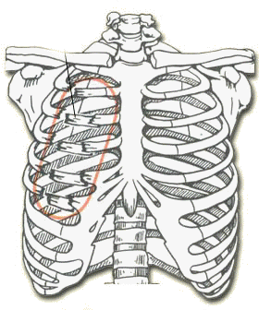
Flail Chest
Chest Injuries – Component 8
Two or more rib and sternum fractures in two or more places
Usually occurs from blunt trauma
The chest wall will lose the rigid segment that usually supports the chest
The flail segment will start to move inwards on inspiration and outwards on expiration, because of this movement the underlying lung may become inadequately ventilated
It is possible that with each rib fracture there could be a loss of up to 100mls of blood
Notes:
Ref: Ambulance Care Essentials 2nd Edition – Chapter 16 pg 275
JRCALC PLUS – Guidelines – Trauma – Thoracic Trauma

Slide 14
Pneumothorax
Chest Injuries – Component 8
The lungs are surrounded by a plural membrane, which has two layers :
The outer layer (parietal pleura) lines the chest wall
The inner layer (visceral pleura) covers the lungs
Between them is the pleural space, PNEUMOTHORAX is air in that pleural space.
Notes:
Ref: Ambulance Care Essentials 2nd Edition – Chapter 16 pg 272-273
JRCALC PLUS – Guidelines – Trauma – Thoracic Trauma

Slide 15
Pneumothorax
Chest Injuries – Component 8
Can be Spontaneous (ie no obvious cause)
Can be caused by trauma (penetrating & blunt)
Small simple pneumothoraces are a frequent occurrence in blunt trauma and if no known cause is found they are classified as spontaneous
Spontaneous Pneumothorax can be common and benign AS LONG as it does not progress to a tension pneumothorax
Symptoms depend on the size of the pneumothorax (the amount of air collecting in the thoracic cavity) some can be TIME CRITICAL and LIFE THREATENING
Notes:
Ref: Ambulance Care Essentials 2nd Edition – Chapter 16 pg 272-273
JRCALC PLUS – Guidelines – Trauma – Thoracic Trauma

Slide 16
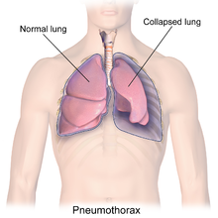
Pneumothorax
Chest Injuries – Component 8
If more and more air is able to occupy
the thoracic cavity it can put pressure
on the lung causing it to collapse
Eventually it can also cause other structures to ‘shift’ away from the pressure (eg trachea)
It can also put pressure on the blood vessels returning blood to the heart and to the heart itself causing obstructive shock
Notes:
Ref: Ambulance Care Essentials 2nd Edition – Chapter 16 pg 272-273
JRCALC PLUS – Guidelines – Trauma – Thoracic Trauma

Slide 17
Open Pneumothorax
Chest Injuries – Component 8
Occurs from penetrating trauma – the resulting hole in the chest wall allows air to enter the pleural space
As the chest wall expands during inspiration, air enters the pleural space. If the wound is large enough, there may be free movement of air into and out of the affected lung during respiration.
This can be referred to as a “ Sucking chest wound”
Notes:
Ref: Ambulance Care Essentials 2nd Edition – Chapter 16 pg 272-273
JRCALC PLUS – Guidelines – Trauma – Thoracic Trauma

Slide 18
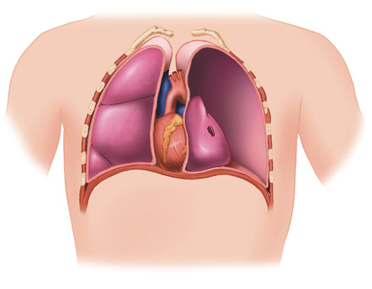
Tension Pneumothorax
Chest Injuries – Component 8
Life-Threatening Emergency
Air enters the thoracic cavity
(pleural space) and cannot escape
Can occur from various causes – penetrating trauma, blunt trauma (perhaps from a # rib) or crushing injury or existing medical causes
Notes:
Ref: Ambulance Care Essentials 2nd Edition – Chapter 16 pg 272-273
JRCALC PLUS – Guidelines – Trauma – Thoracic Trauma

Slide 19
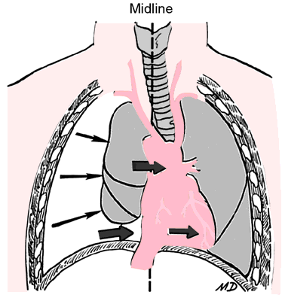
Tension Pneumothorax
Chest Injuries – Component 8
Life-Threatening Emergency
As the tension pneumothorax expands it occupies space in the thoracic cavity – the lung collapses, structures shift away from the high pressure and blood flow can be impeded by the pressure placed upon the blood vessels
Your patient will become increasingly –
Dyspnoeic, tachycardic & hypotensive
And you may notice –
Reduced chest wall movement, reduced (or absent) breath sounds, distended neck veins, tracheal deviation
Notes:
Ref: Ambulance Care Essentials 2nd Edition – Chapter 16 pg 272-275
JRCALC PLUS – Guidelines – Trauma – Thoracic Trauma

Slide 20
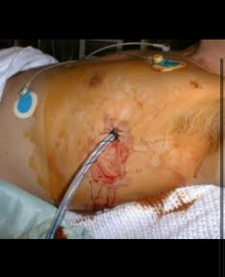
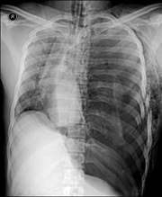
Tension Pneumothorax
Chest Injuries – Component 8
Your patient needs advanced clinical interventions
Notes:
The x-ray shows a tension pneumothorax on the patients left side.
Black represents air – lots of it!
The white tissue on the patients right side represents body tissues

Slide 21
Haemothorax
Chest Injuries – Component 8
Blood in the thoracic (pleural) cavity
Usually occurs from penetrating trauma injuring major blood vessels but could be blunt deceleration shearing injury
As blood fills the thoracic cavity it takes up space normally occupied by the lungs and they collapse
The patient has a dual problem – hypoxia & hypovolaemia
Depending on the severity of the injury and blood loss a haemothorax can be TIME CRITICAL and LIFE THREATENING
Notes:
Ref: Ambulance Care Essentials 2nd Edition – Chapter 16 pg 275
JRCALC PLUS – Guidelines – Trauma – Thoracic Trauma

Slide 22
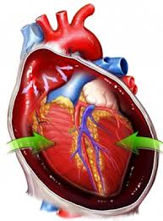
Cardiac Tamponade
Chest Injuries – Component 8
Excessive fluid in the pericardial sac compresses the heart limiting its ability to pump
More common in penetrating injury
Only requires 20 – 30ml of
blood to cause tamponade
This is TIME CRITICAL AND a LIFE THREATENING condition
Notes:
Ref: JRCALC PLUS – Guidelines – Trauma – Thoracic Trauma

Slide 23
Assessment
Chest Injuries – Component 8
Assess C ABCDE
Is there a catastrophic haemorrhage
Is there an airway issue
Is there a breathing issue
Is there a circulation issue
Does the patient require other interventions - request APP, HEMS, Paramedic ASAP
Is the patient TIME CRITICAL
Is there a disability issue
Some major chest injuries will fail at B – if you cannot correct the problem, undertake a time critical transfer to a major trauma unit
Notes:
Ref: Ambulance Care Essentials 2nd Edition – Chapter 16 pg 272-275
JRCALC PLUS – Guidelines – Trauma – Thoracic Trauma

Slide 24
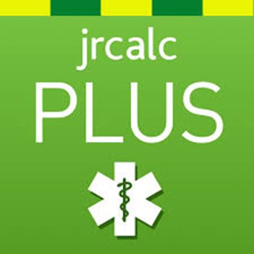
Assessment
Chest Injuries – Component 8
Primary Survey - Breathing - EXPOSE THE CHEST !!!!!!!
COUNT respiratory rate, assess effort of breathing, assess SPO2 levels
LOOK for wounds, swelling, deformity, bruising
LOOK at chest wall movement (symmetrical, paradoxical)
LOOK (don’t forget ) at the back of the chest & the axilla
LOOK at the neck – distended neck veins, tracheal deviation (TWELVE)
LISTEN – once to both lungs to confirm air entry
FEEL – injuries, deformities, instability, tenderness, depth & symmetry of movement
Some major chest injuries will fail at B – if you cannot correct the problem, undertake a time critical transfer to a major trauma unit
Notes:
Ref: Ambulance Care Essentials 2nd Edition – Chapter 16 pg 272-275
JRCALC PLUS – Guidelines – Trauma – Thoracic Trauma
Look at the neck- Reference to TWELVE mnemonic
(Trachea midline, wounds, emphysema (surgical), laryngeal crepitus, venous engorgement, exclude haemo-/ pneumo- thorax

Slide 25
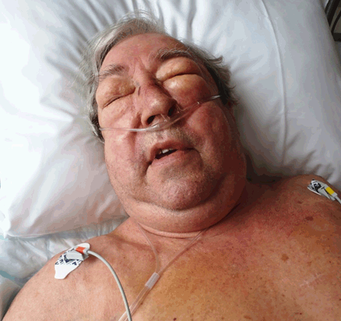

Subcutaneous Emphysema
Associated with severe thoracic injury
Extra-pleural
Intra-pleural
Focus on ABC management
TWELVE mnemonic
          (JRCALC)
Notes:
Bø, I.C and Nielsen, E.W. (2016). Massive subcutaneous emphysema after domestic fall. International Journal of Case Reports and Images. 7(2), pp.132-134
Intra-pleural: injury/ leakage typically causes a pneumothorax; air leaks through the parietal pleura into the thoracic wall
Extra- pleural: Tracheal/ bronchial injury allows air to leak into the mediastinum and further into the anterior neck’s soft tissue
Described variously as, ‘bubble wrap’, ‘Rice Crispies’ , ‘fresh snow’
TWELVE mnemonic: Tracheal deviation; wounds; emphysema (subcutaneous); laryngeal crepitus; venous engorgement; exclude haemo-/ pneumo-thoraces

Slide 26

Assessment
Chest Injuries – Component 8
Secondary Survey
Done enroute to hospital if patient is time critical
Assess for all other injuries (top to toe examination)
ECG
Listen to chest sounds – report findings
Pain Score
Thorough review of MOI
PMHx
Notes:
Ref: Ambulance Care Essentials 2nd Edition – Chapter 16 pg 272-275
JRCALC PLUS – Guidelines – Trauma – Thoracic Trauma

Slide 27
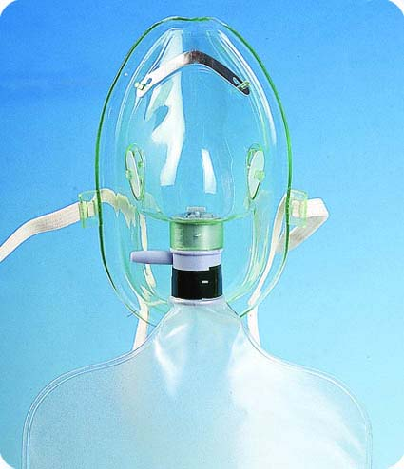
Management
Oxygen
Chest Injuries – Component 8
JRCALC Guidelines
Major Trauma (including chest trauma)
15 litres per minute
Reservoir mask (non-rebreather mask)
“Administer the initial oxygen dose until the vital signs are normal, then reduce oxygen dose and aim for target saturation within the range of 94-98%”
Notes:
Ref: JRCALC PLUS – Meds - Oxygen

Slide 28

Analgesia
Chest Injuries – Component 8
Entonox
JRCALC –Contra-indication – Do not give nitrous oxide for patients with chest injuries and a clinically suspected pneumothorax
JRCALC – Caution - Avoid using Entonox in a patient with a chest injury as there is a risk of enlarging a pneumothorax
Request Paramedic intervention – Morphine, IV Paracetamol as soon as possible if required.
Notes:
Ref: JRCALC PLUS – Guidelines – Meds – Entonox
JRCALC contraindication does not preclude all patients with chest injury from receiving Entonox, specifically refers to those where a pneumothorax is believed present. If an AAP is not confident in determining whether this contra-indication applies, they should seek guidance from the senior clinician, who may determine another method of analgesia is appropriate for a chest injury.
Pneumomediastinum is defined as the presence of air or other gas in the mediastinum, and is also known as mediastinal emphysema
Pneumoperitoneum is pneumatosis (abnormal presence of air or other gas) in the peritoneal cavity, a potential space within the abdominal cavity
Polytrauma or multiple trauma is a medical term describing the condition of a person who has been subjected to multiple traumatic injuries, such as a serious head injury in addition to a serious burn. It is defined via an Injury Severity Score (ISS) equal to or greater than 16

Slide 29
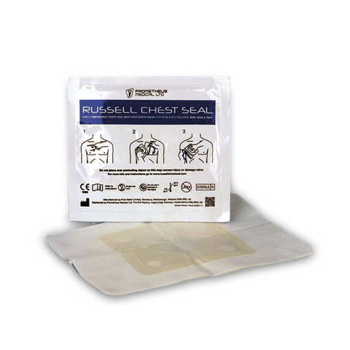
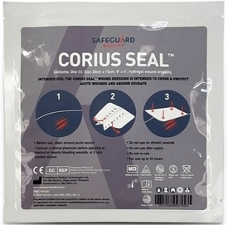
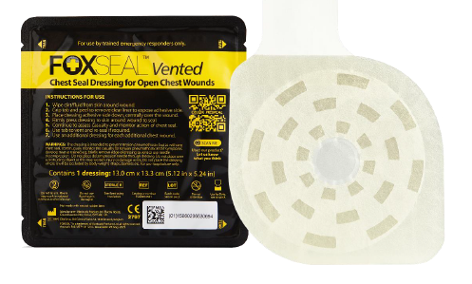


Chest Injuries – Component 8
Wound Dressings
Russell Chest Seal
Corius Seal Dressing
Fox Chest seal
Notes:
See clinical equipment information bulletin, no 6 (March 2023)
And clinical equipment bulletin no 019 (Sep24)
Tutor explain the use of the :
Russell chest seal
Corius Seal dressing
Fox Chest seal
Fox seal:
Can be applied in any orientation
2 per trauma kit
Same indications as other LAS chest seals
Has a tab to prevent touching the sticky seal

